Slide 1

SATYAM TECHNOCRATS
Line Automation | Robotics | Assembly Automation
Packaging | Conveying | Palletizing

Slide 2
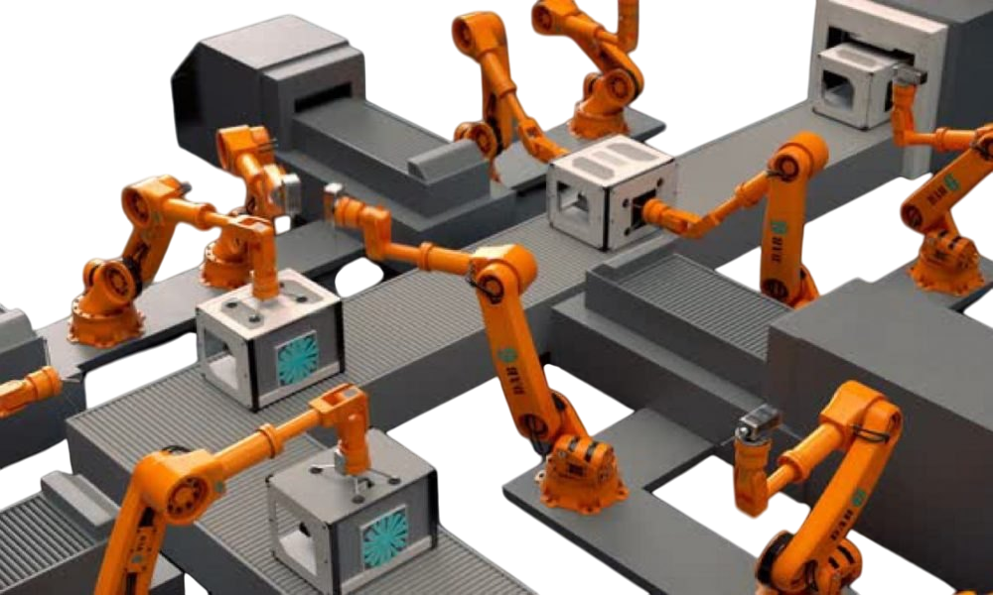

Turnkey Solutions for Automation

Slide 3
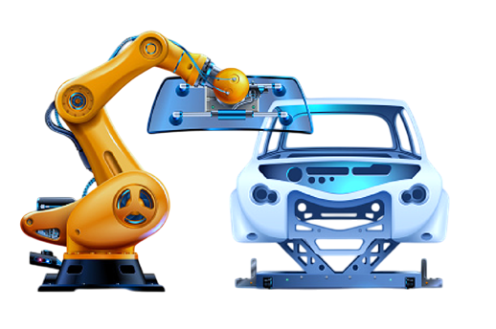
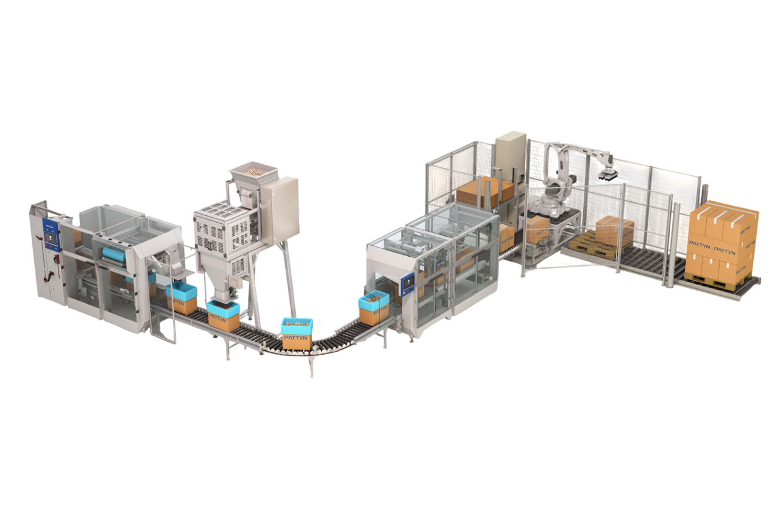
Our Expertise
Line Automation Solutions
End of Line
Packaging Solutions
Automotive & Ancillaries
Electrical & Ancillaries
Electronics
General Metal
Food, Pharma, FMCG, Dairy
Electronics
LVSD Metal Industry
Notes:
LVSD – Large Volume Small Dimension

Slide 4
Vision
Globally recognised technocrats in Robotics & Packaging Automation Technology by,
Mission
To accelerate the industries growth by providing,
Core Values
Customer Centric
Innovative
Cost Effective
Robotic & Packaging Automation solutions
Delivering greater value to the stakeholders
Becoming a great place to work, where people are inspired to be the best they can
Quality First
Team Work & Integrity
Openness

Slide 5
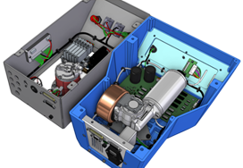
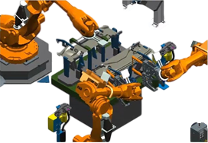
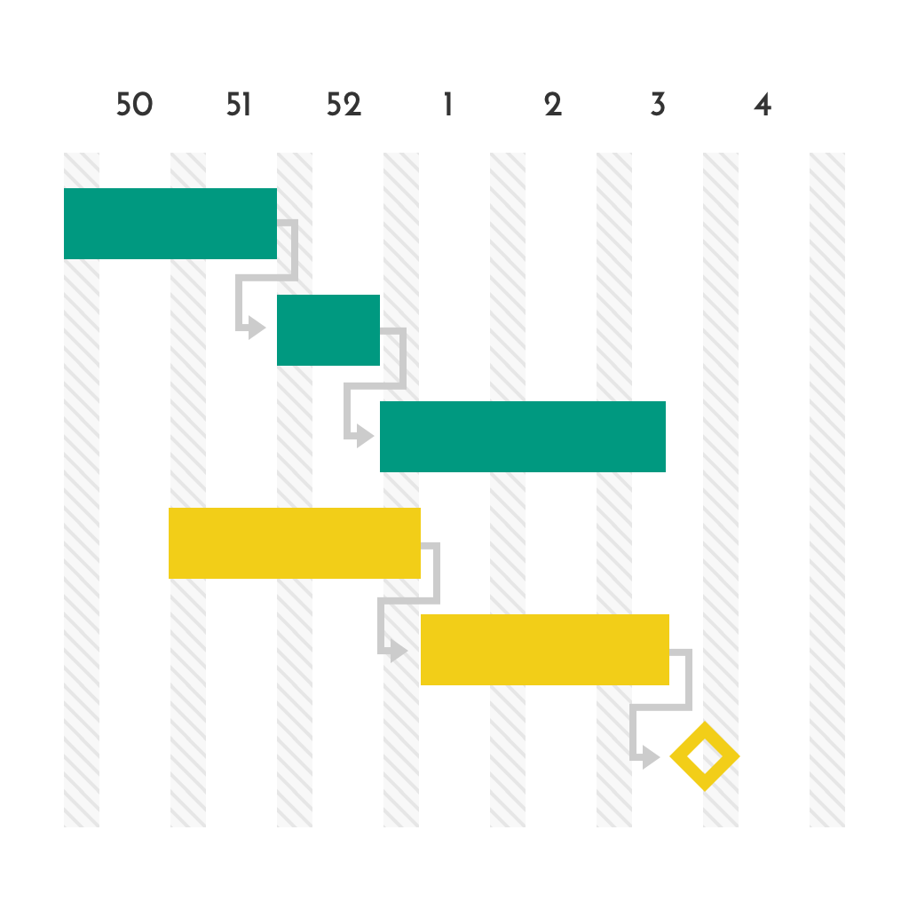



Competencies
Integrated Mechanical & Electrical Design
Virtual Commissioning & Simulation
Agile Project Management
Research & Testing Setup of 6000 sq. ft.
Remote Support Team
Continuous Innovation & Improvement

Slide 6
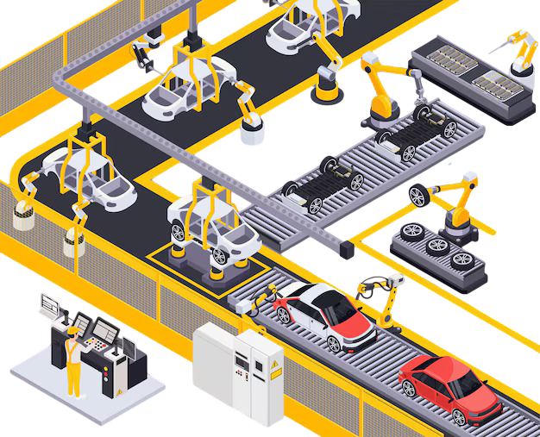
Line Automation
Standard Solutions

Slide 7
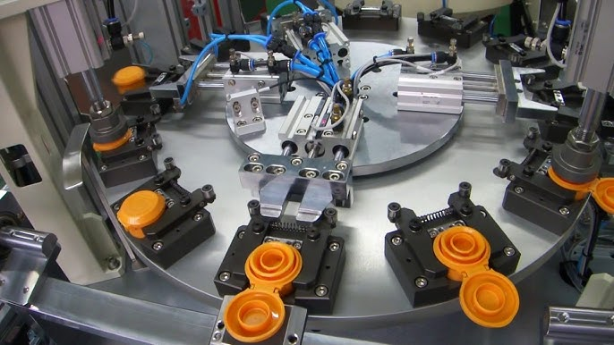
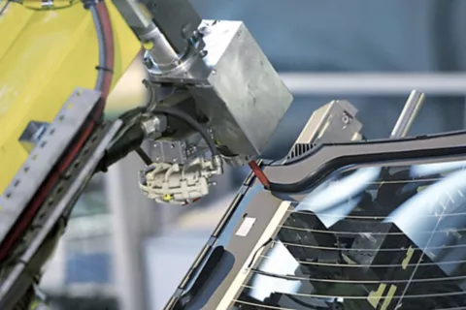
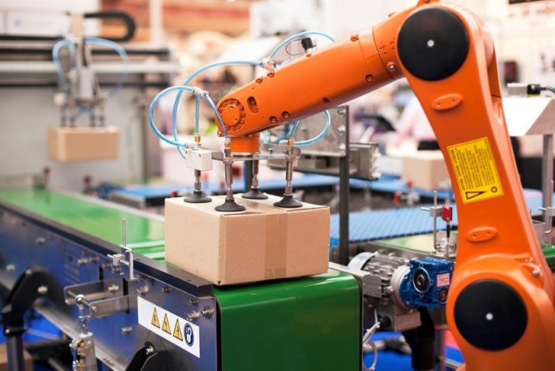
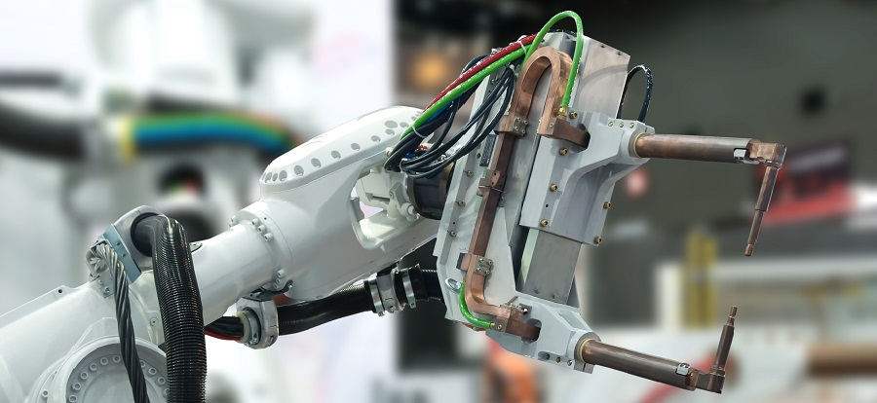
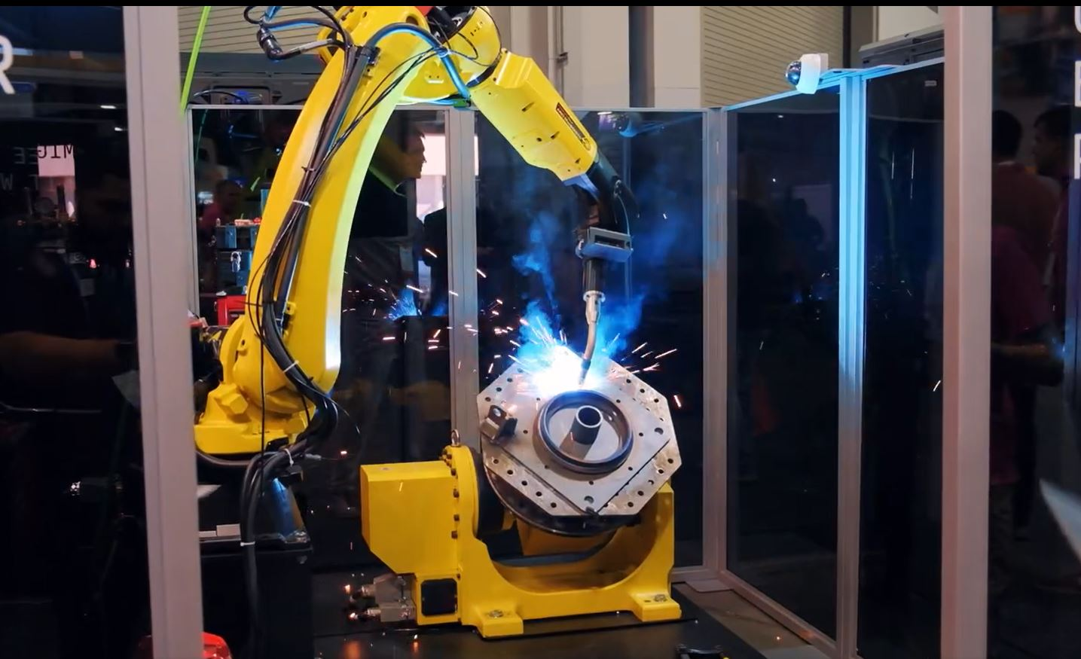
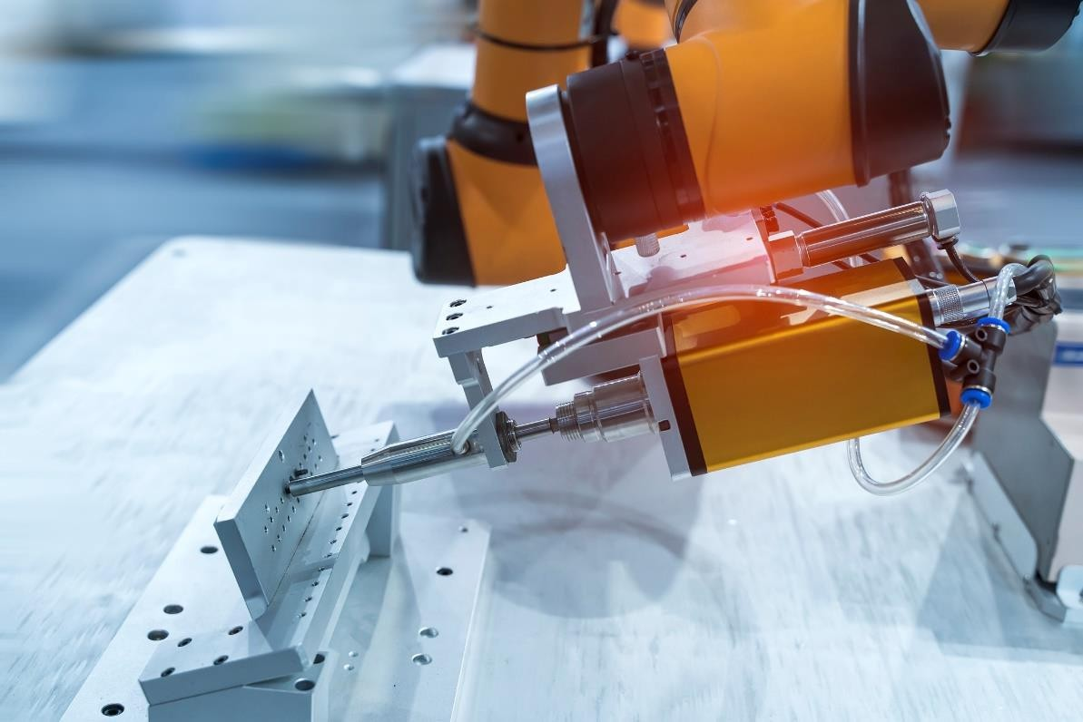
Assembly Lines / Machines
Gluing / Dispensing
Material Handling
Spot Welding
MIG / TIG Welding
Robotic Fastening / Hole Making

Slide 8
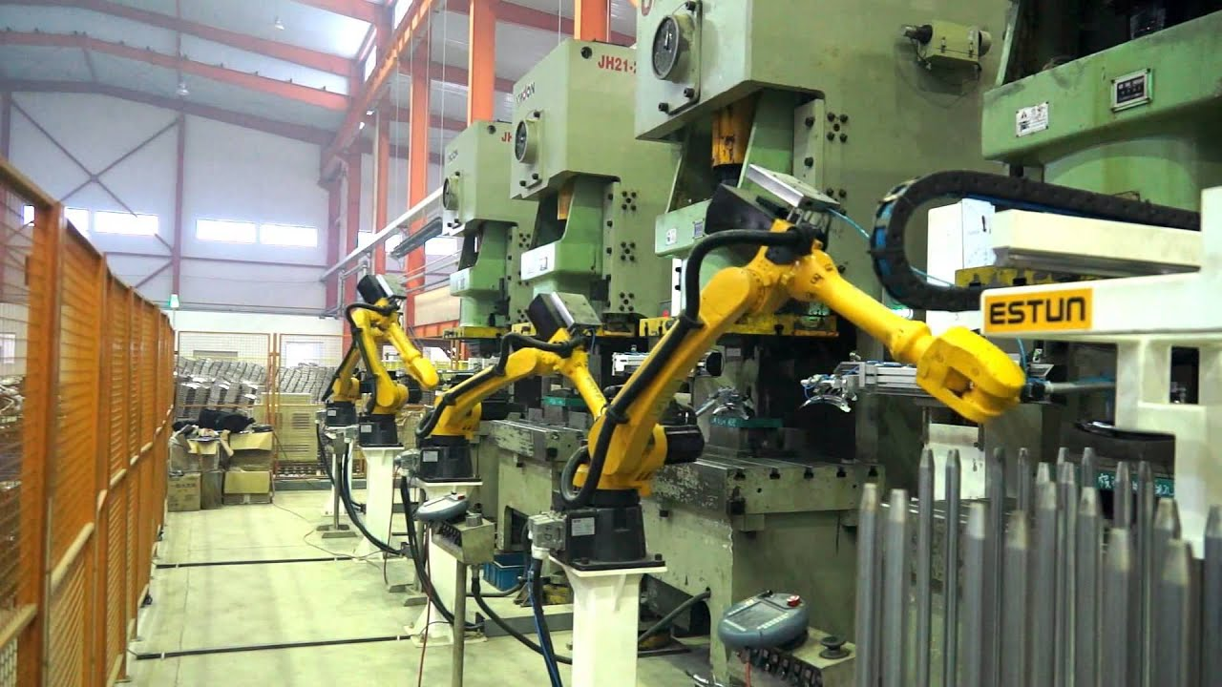
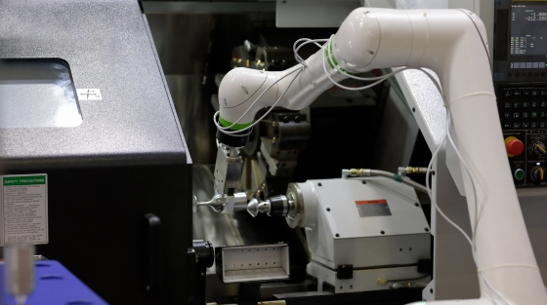
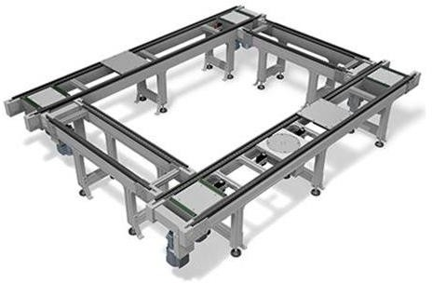
Press Line Automation
Machine Tending
Pallet Conveyors

Slide 9
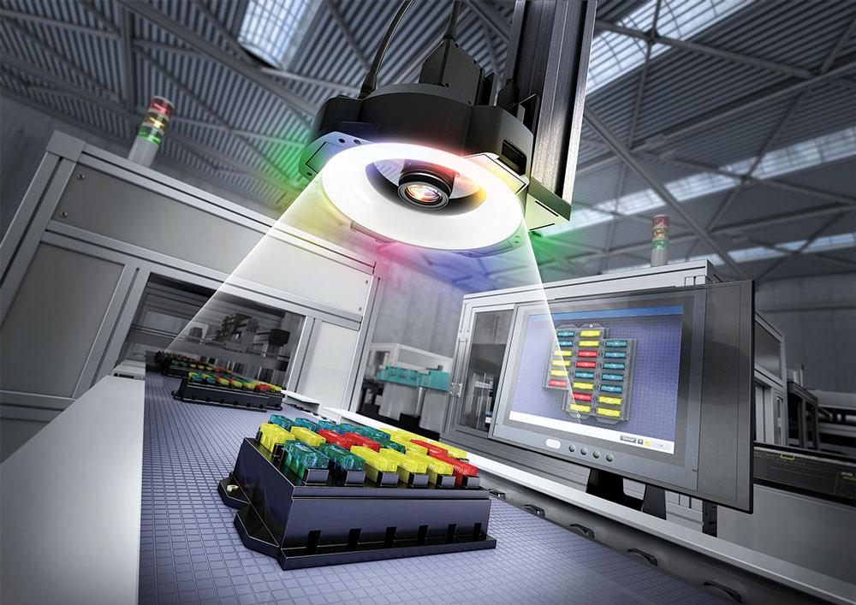
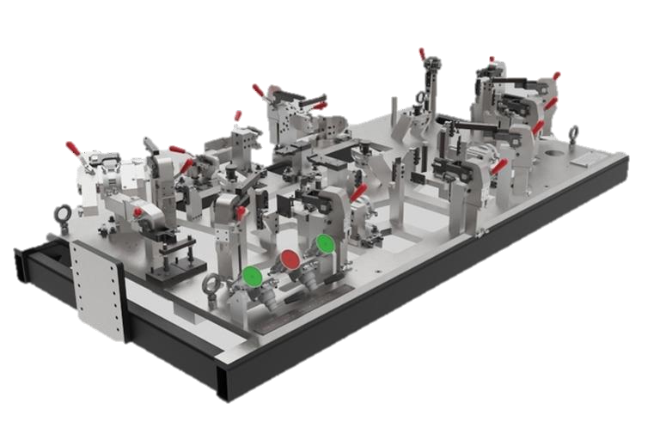
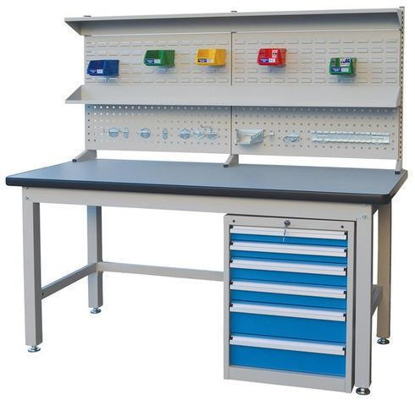
Integrated Solutions
Vision Based Automation
Fixturing & Tooling
Modular Workbenches

Slide 10

End of Line Packaging
Standard Solutions

Slide 11
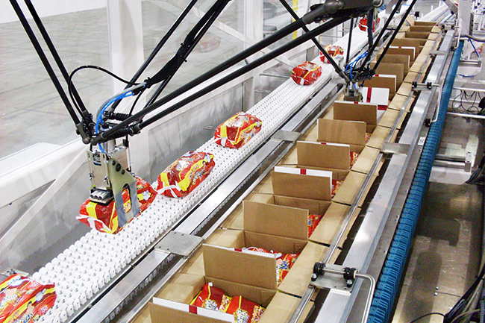
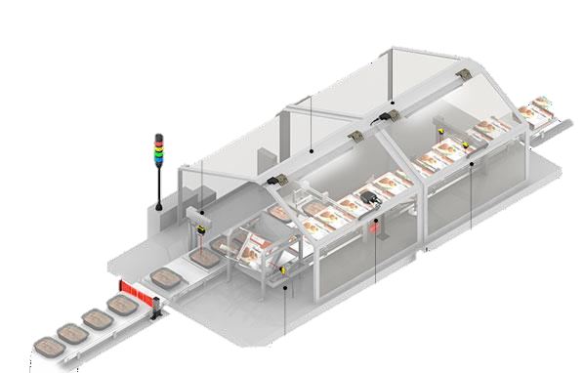
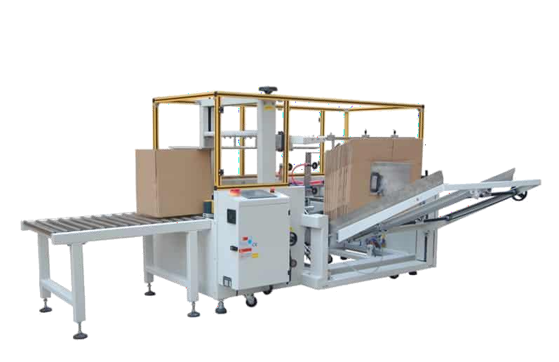
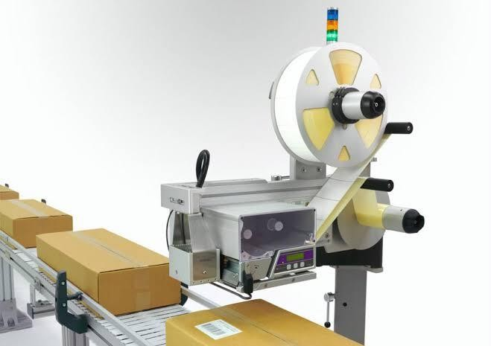
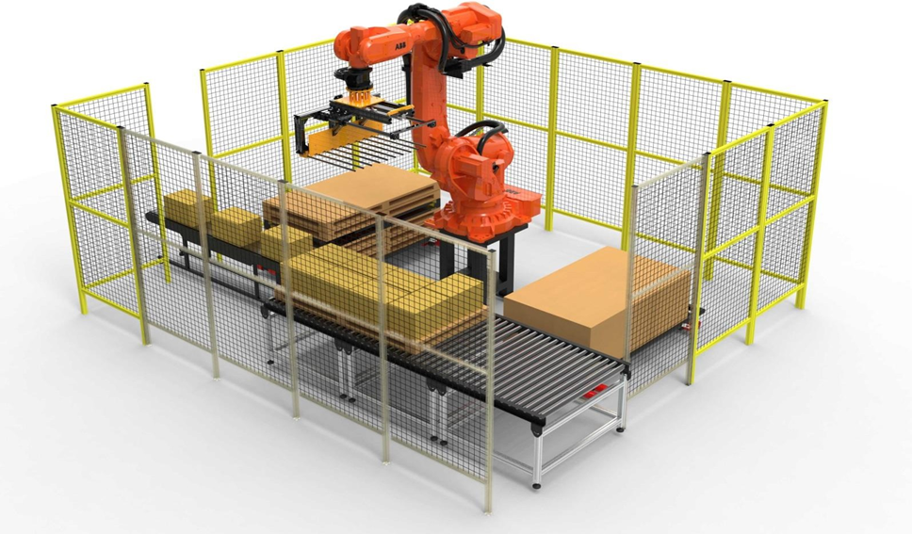
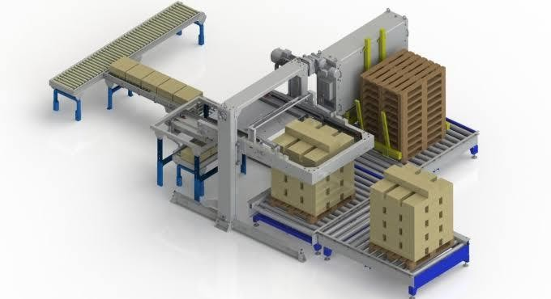
Case Packers
On-Line Cartoners
Case Formers
Printers & Labellers
Robotic Palletizers
Layer Palletizers &
Pallet Destack Feeders

Slide 12
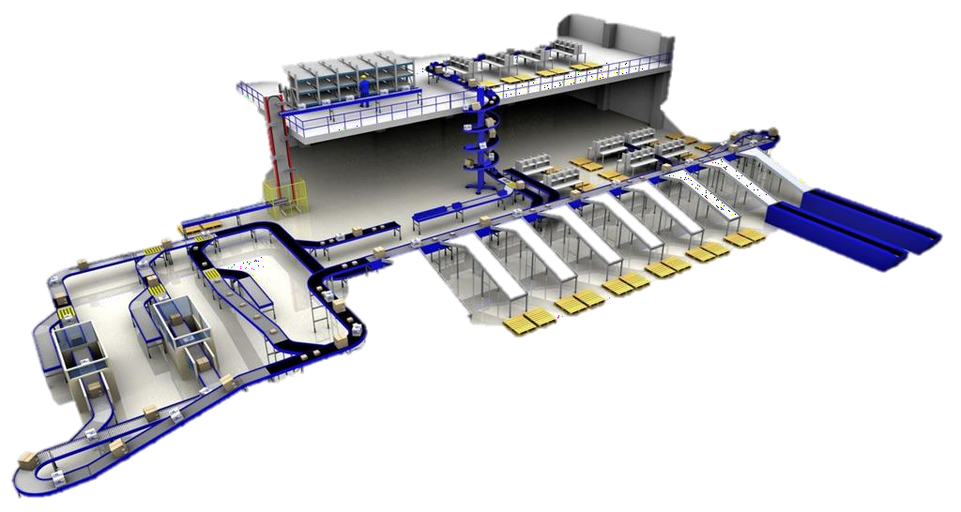
End to End Conveying & Sorting

Slide 13
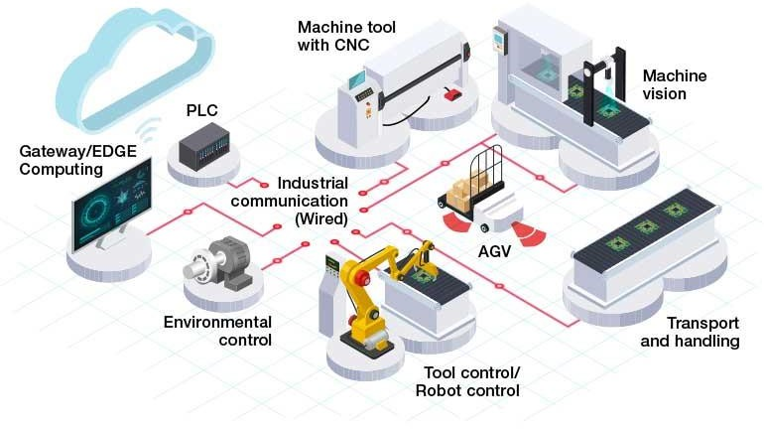
Industrie 4.0 - IIOT

Slide 14

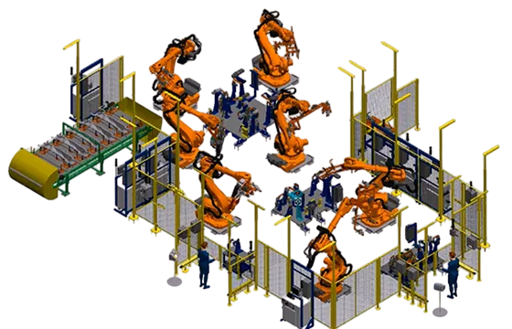
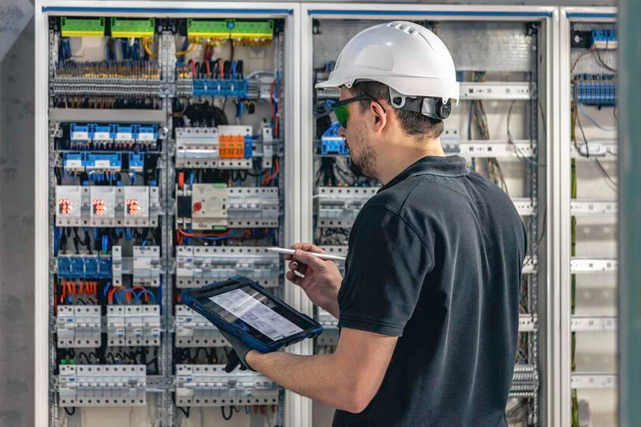
Engineering Services
Virtual Commissioning
Industrial Engineering
& Consultation
Technical Services
& Support

Slide 15


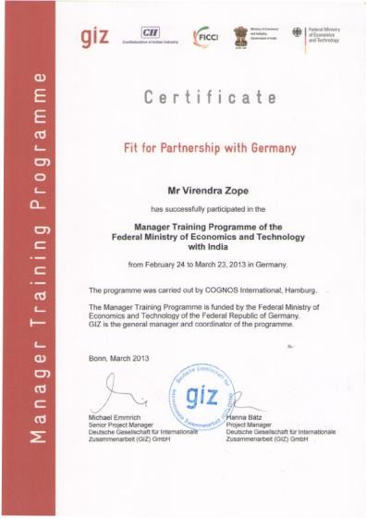
Accolades
Fit for Partnership with Germany
By GIZ, Germany

Slide 16



CII Business Delegation to Belgium & Sweden
Accompanying Shri Pranab Mukherjee,
Hon’ble President of India.

Slide 17



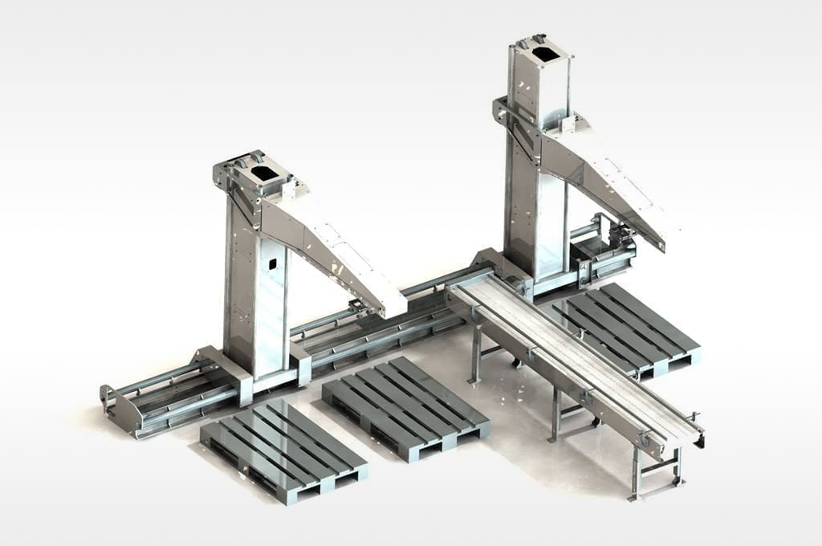
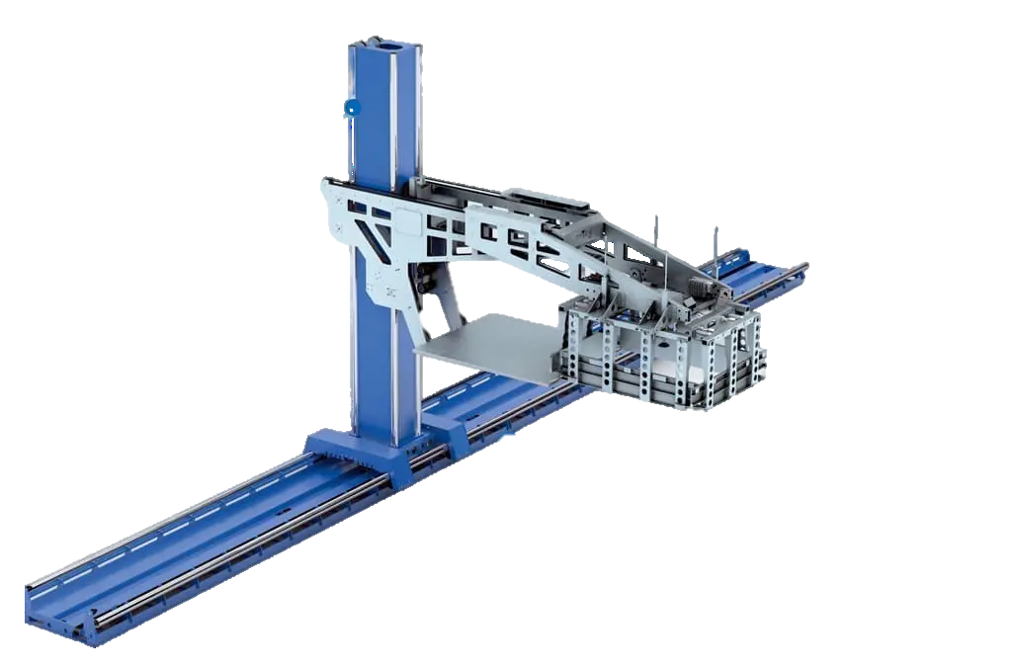
International Collaborations
Palletizing Robots
De-Palletizing Robots

Slide 18

Projects Executed

Slide 19
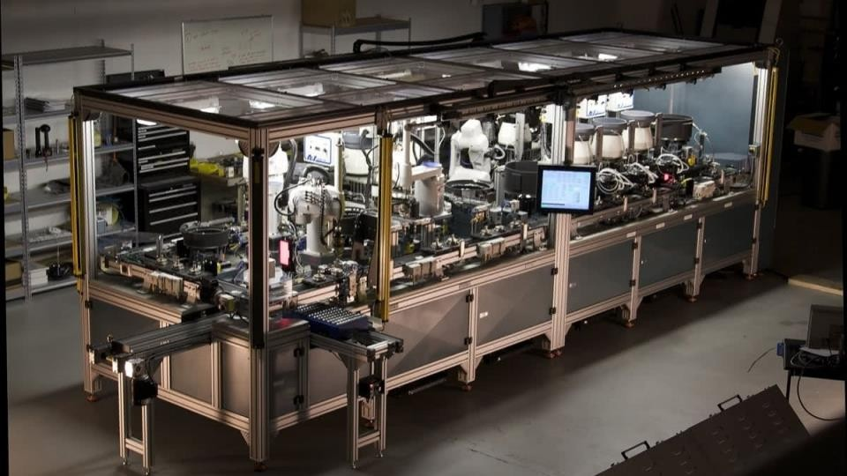
Assembly Machine Electronics Industry

Slide 20
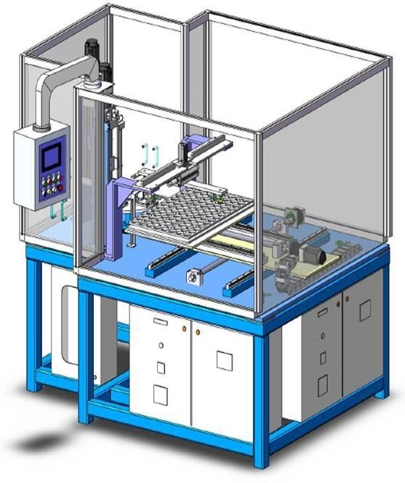
Piston Ring Assembly Machine 2W Manufacturer
Method : Two Stage Mandrel Dispensing
Handling : Robotic Arm – Full Automatic
Ring Miss detection by Vision Camera
O/P Rate : 8 Pistons / Min

Slide 21
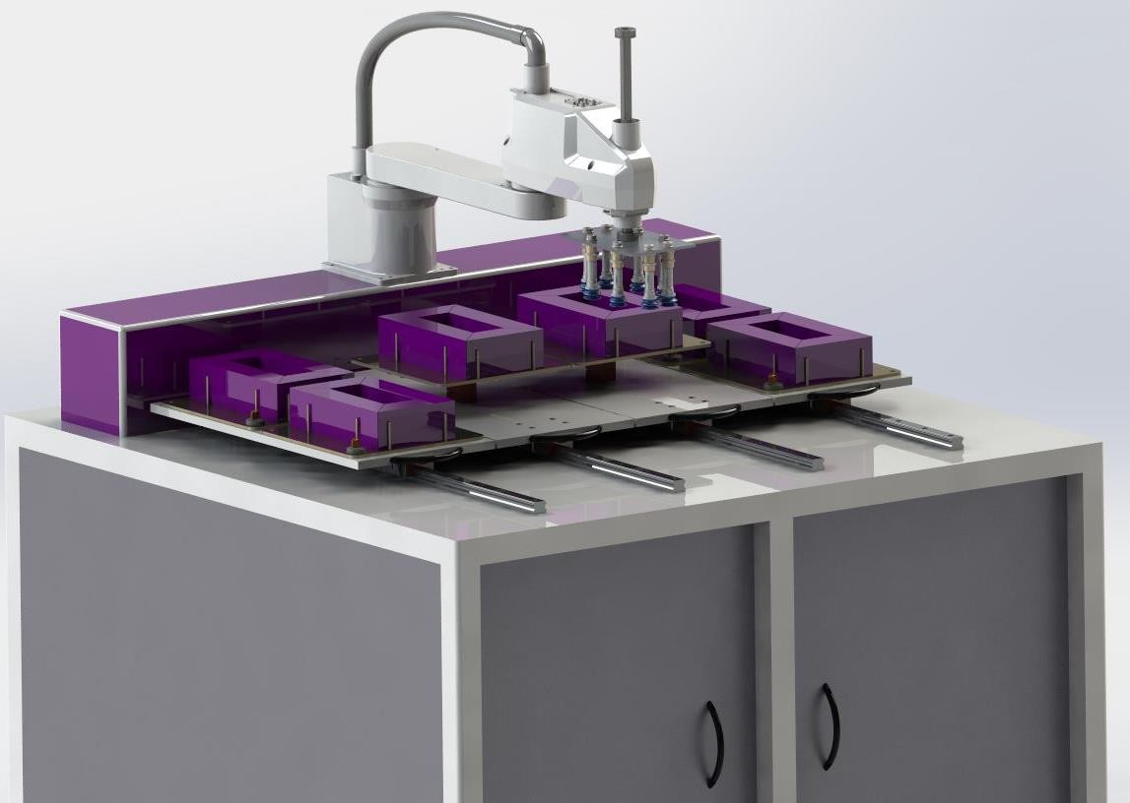
Robotic Transformer Core Assembly Electrical Industry
Fast Assembly using SCARA Robot
Efficiency improvement by 30%
Smooth fixture movement
Assembly with alternate 180⁰ orientation

Slide 22
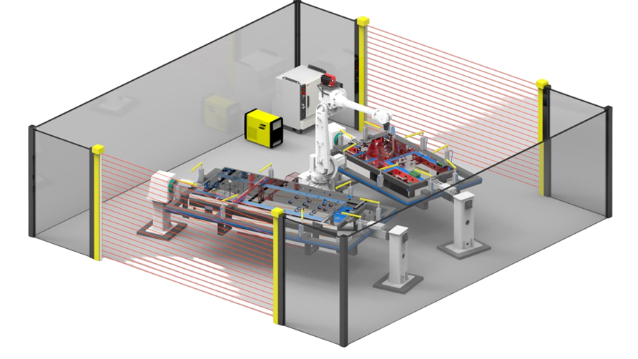
Robotic MIG Welding for Chassis Construction Equipment Manufacturer

Slide 23
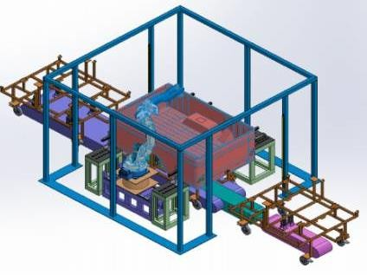
Robotic MIG Welding for Cargo Trunk Automobile Industry

Slide 24
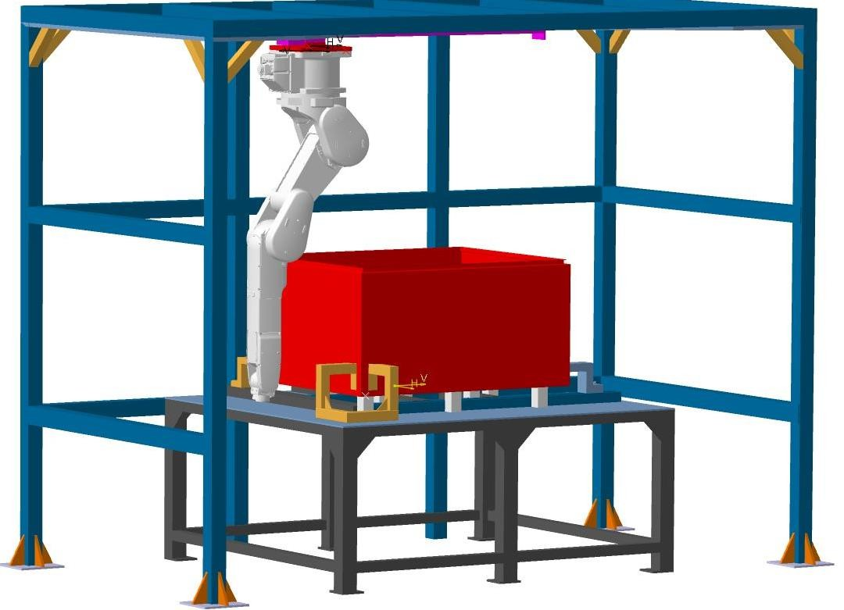
Robotic TIG Welding for SS Panel Panel Manufacturer
Suspended Robotic Operation
Compact Layout
Flexible System considering many variants
7th Axis Linear Track

Slide 25
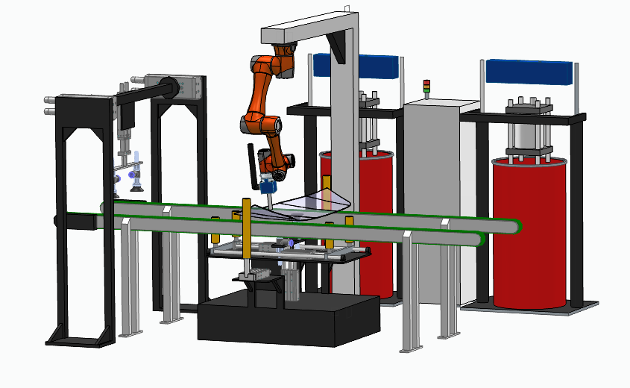
Robotic Windshield Gluing Cell Automobile Industry

Slide 26
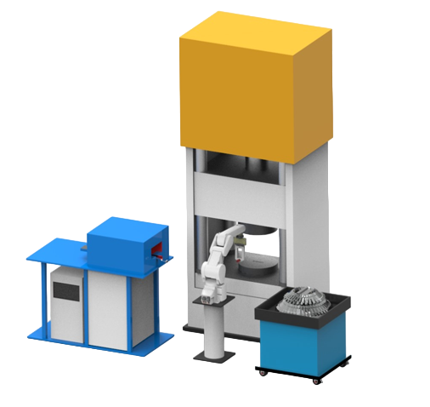
Robotic Foundry Press Tending Foundry Press Shop
Heated job at 800⁰C
End of Arm Gripper design for minimum heat dissipation

Slide 27
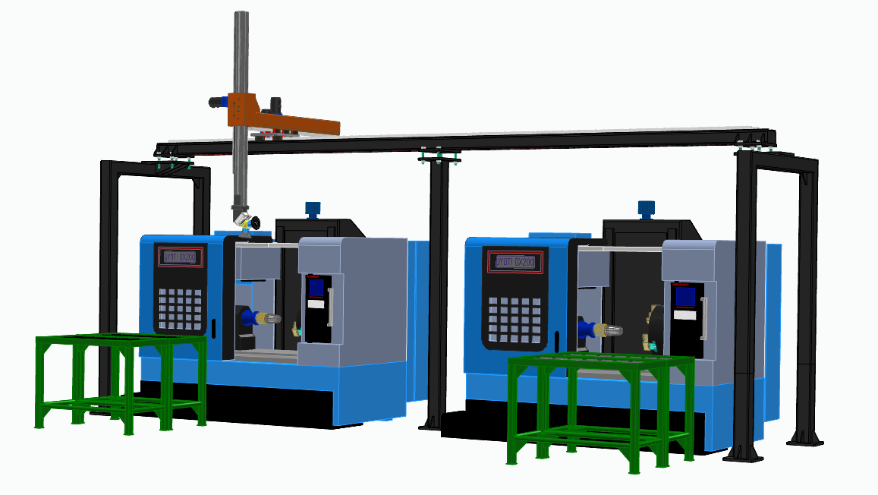
Gantry Robot Machine Tending EV Manufacturer
Simultaneous operation of 2 machines
Easy teaching of Gantry Robot
Swivel Gripper design for Holding finished & unfinished jobs

Slide 28
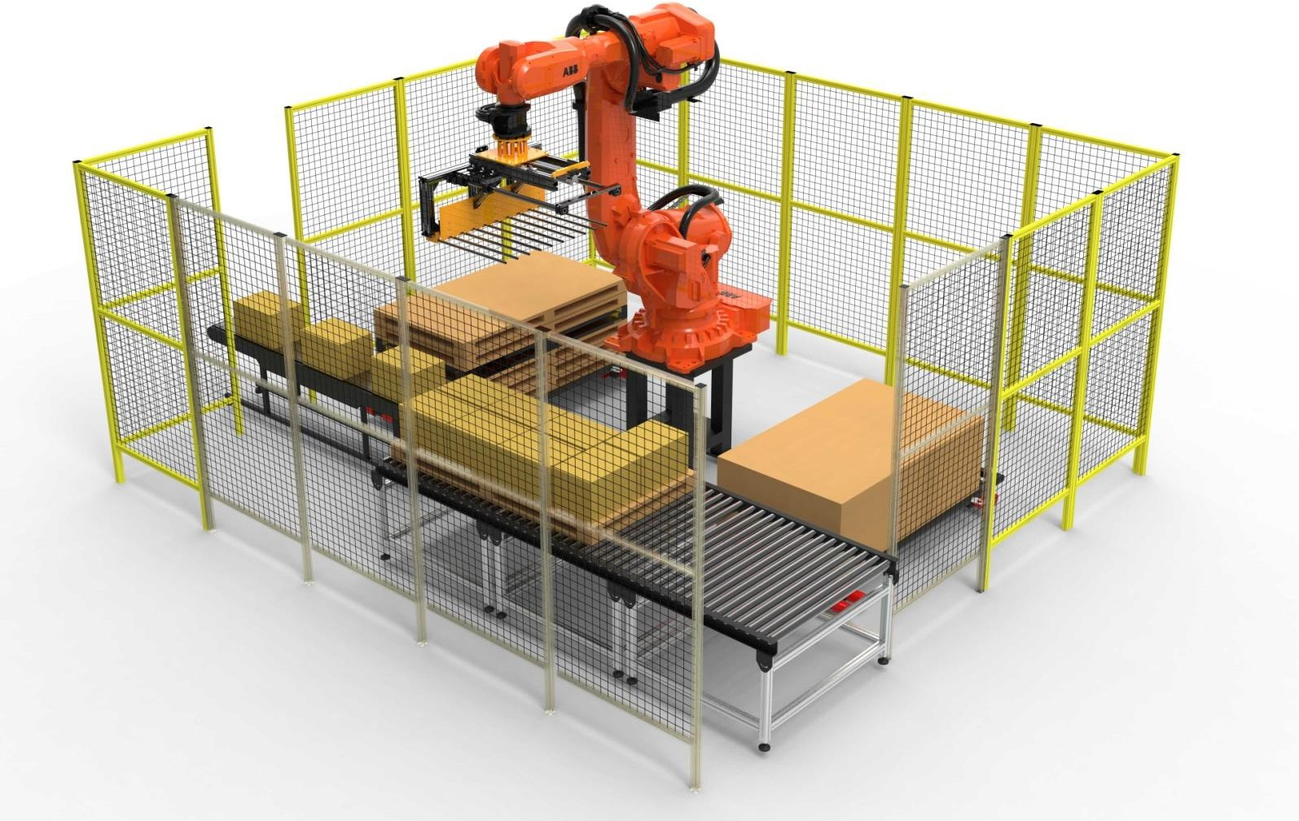
Robotic Palletizing for Engine Boxes 2W Manufacturer

Slide 29
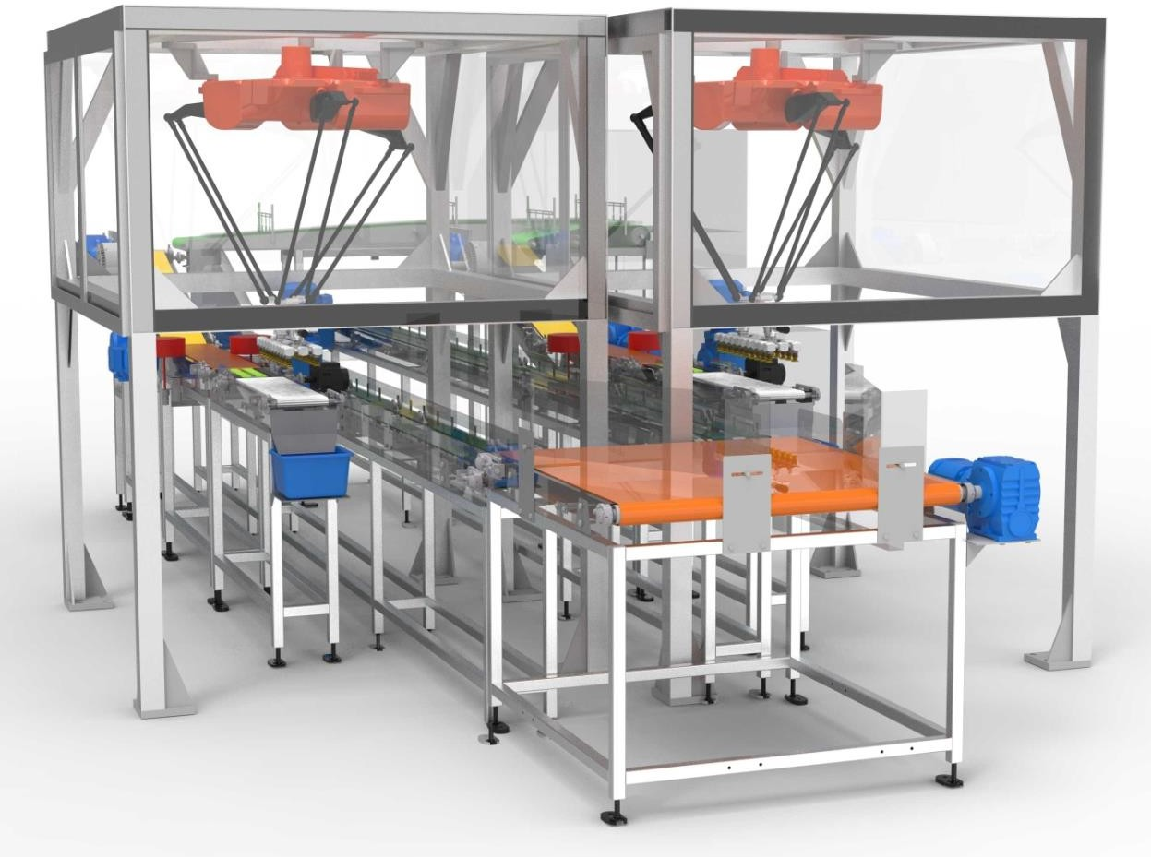
Twin Line Case Packer Ice Candy Manufacturer

Slide 30
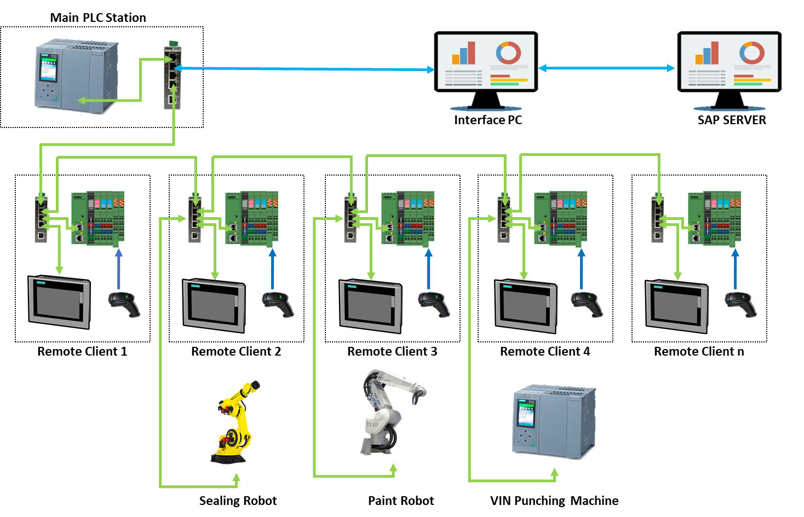
End to End Traceability Car Manufacturer

Slide 31








































Clientele

Slide 32








Phone
+91 8956014042
Email
info@satyamtechnocrats.com
Global Presence
India, Germany, UAE, Singapore
Contact Us

Slide 33

Thank you

